Slide 1

Housing Price Prediction

Slide 2
Introduction
Houses are one of the basic needs of every individual around the world, housing and real estate markets are the major contributors of world’s economy.
House prices increase every year, so there is a need for a system to predict house prices. House price prediction can help the developer determine the selling price of a house and can help the customer to arrange the right time to purchase a house.
There are three factors that influence the price of a house which include physical conditions, concept and location.
So, Machine Learning models are used to predict the actual value of the prospective properties and decide whether to invest in them or not and draw insights from the given variables and know which variables contribute much for our prediction.

Slide 3
Problem Statement
Real estate is a very large market which has a huge demand, where selling and buying of houses takes place. These days buying a house involves huge amounts of money to be invested.
Data science comes as a very important tool to solve problems in the domain to help the companies increase their overall revenue, profits, improving their marketing strategies and focusing on changing trends in house sales and purchases. Predictive modelling, Market mix modelling, recommendation systems are some of the machine learning techniques used for achieving the business goals for housing companies.
Our problem is related to one such housing company which is US-based housing company named Surprise Housing who has decided to enter the Australian market. The company uses data analytics to purchase houses at a price below their actual values and flip them at a higher price. For the same purpose, the company has collected a data set from the sale of houses in Australia.
Housing prices keep changing day in and day out and sometimes are hyped rather than being based on valuation. Predicting housing prices with real factors is the main crux of our research project. Here we aim to make our evaluations based on every basic parameter that is considered while determining the price. We use various regression techniques in this pathway, and our results are not sole determination of one technique rather it is the weighted mean of various techniques to give most accurate results.

Slide 4
Analytical Problem Framing
A CSV file has given by a US-based housing company named Surprise Housing who decided to enter the Australian market. The company wants to use data analytics to purchase houses at a price below their actual values and flip them at a higher price. For the same purpose, the company has collected a data set from the sale of houses in Australia. The dataset consists of different columns which we need to use and predict the label.
Our dataset consists of 1460 rows and 81 columns in both train data and test data. We are provided by two datasets of test.csv file, train.csv file. On which we will train on train.csv dataset and predict on test.csv file. I have checked for shape of the data then the train dataset consists of 1168 rows and 81 columns, the test dataset consists of 292 rows and 80 columns.
The data contains Null values which need to be treated using imputing techniques in this I have used mean and mode methods to fill the null values for continuous and categorical values respectively. The Data contains numerical as well as categorical variable which need to be treated using encoding techniques, I have used label encoder to encode the values.
In order to find the relation between the features and label, I have used correlation matrix to check the correlation. Since our price prediction is a continous variable it comes under regression problem so I have used various regression algorithms for prediction of our label and tried achevieing the good performance of the model.

Slide 5
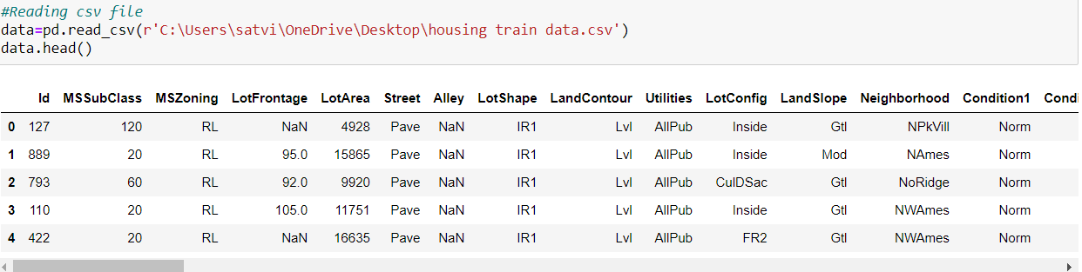
Data Sources and their formats
By using pandas, I have first imported the csv file and it consists of different columns which includes data in it. Our dataset consists of Features and label. After importing I have checked for shape of the dataset and which consists of rows and columns. Then I checked for null values and need to be treated and then I checked for info () method for knowing the type of the data then I checked for stats using describe method.
Our label is price prediction which is a continuous variable based on the values of independent variables our dependent variable depends.

Slide 6
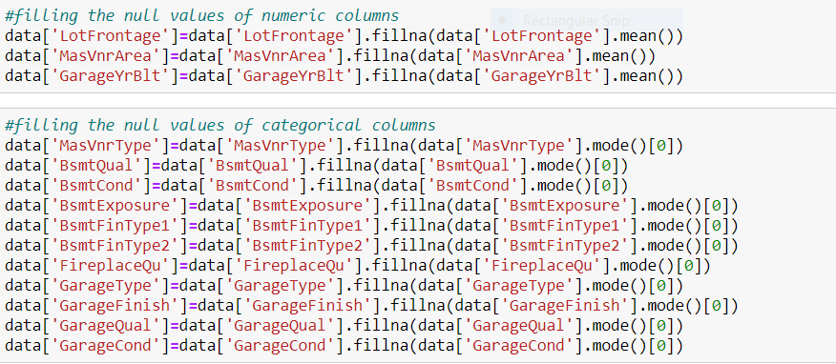
Data Pre-processing
There are many null values present in the dataset by using some of the imputing techniques we need to fill the NaN values using mean or
model based on the type of the data in the columns. For the categorical variables I have use mode method to fill and for continuous
columns I used mean to fill the NaN’s.

Slide 7
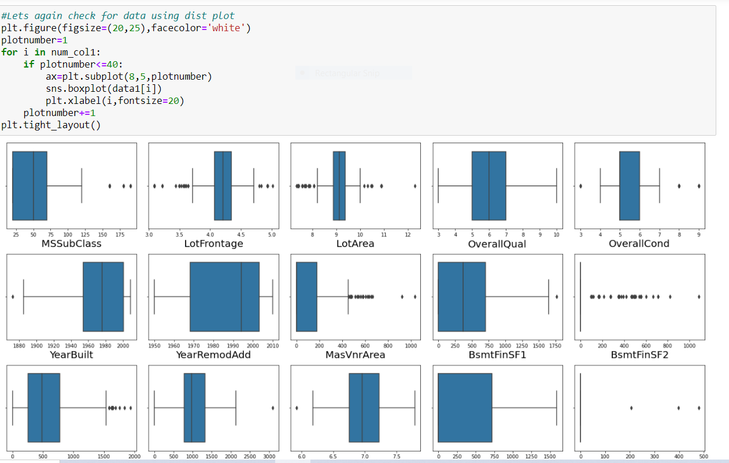
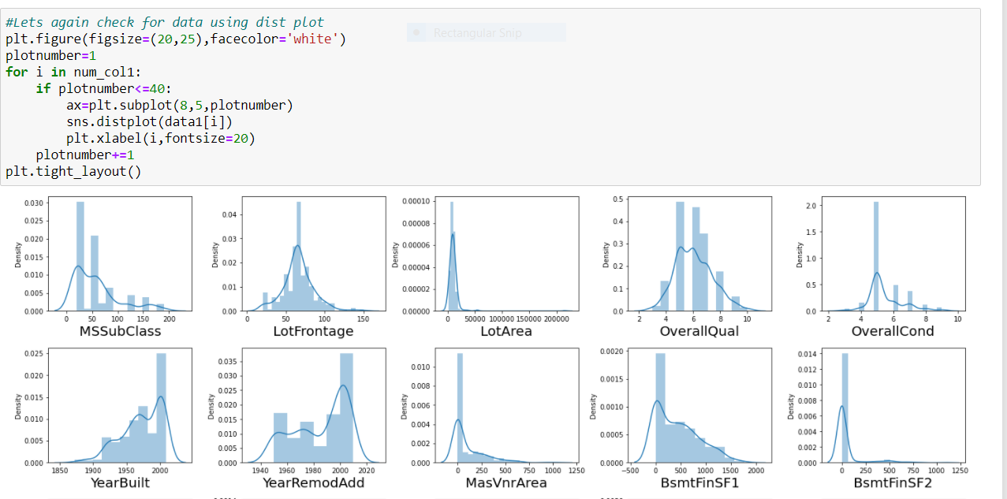
Model/s Development and Evaluation
I have plotted box plots to check for outliers and distribution plots to check the skewness so I found the presence of outliers and skewness in the continuous data. So, I have used Z-Score method for removing the outliers and log transformation method the remove the skewness.
Box plots Distribution plots

Slide 8
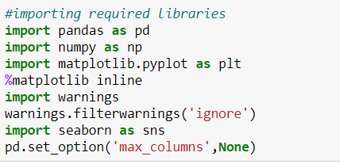
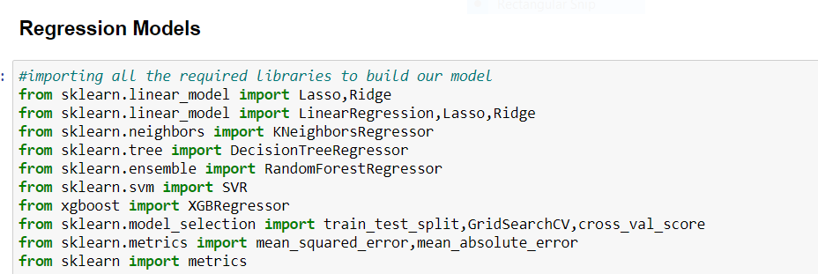
Hardware and Software Requirements and Tools Used
I have used my laptop, Jupiter Notebook which is having GUI interface. Imported necessary libraries from python such as pandas, NumPy, seaborn, matplotlib, then imported the required model libraries from Scikit learn to import our algorithms.

Slide 9
Testing of Identified Algorithms
First, I have used Min Max Scaler to scale the data.
Then, I imported the train_test_split from the module sklearn from model_selection. And used 70% of the data for training and 30% of the data for testing and splitted the data into x-train, x-test, y-train, y-test.
Then, I have used various algorithms for predicting our label using Linear Regression, KNeighbors Regression, Decision Tree Regression, Random Forest Regression, Support Vector Regression, Extreme Gradient Boost Regression, Lasso Regression, Ridge Regression.
Then, For evaluating the model I have used Mean Squared Error (MSE), training score, testing score and root mean squared root (RMSE).

Slide 10
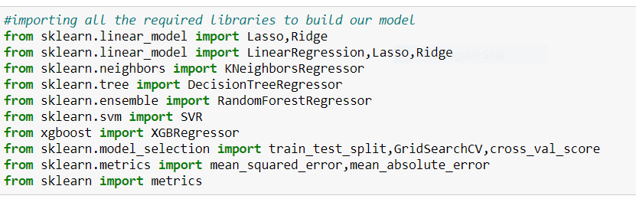
Regression Algorithms

Slide 11
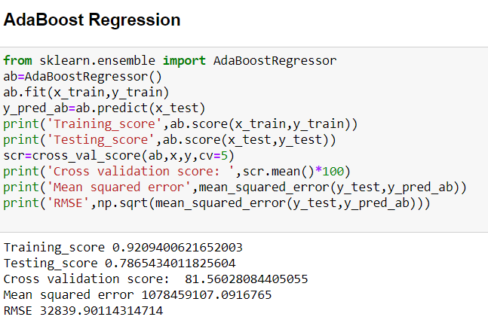
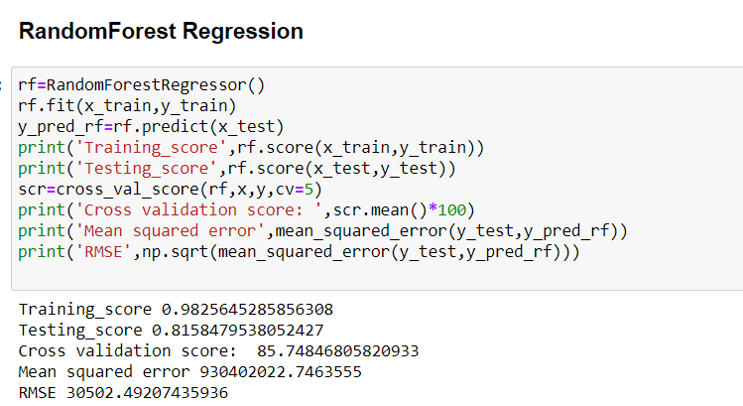
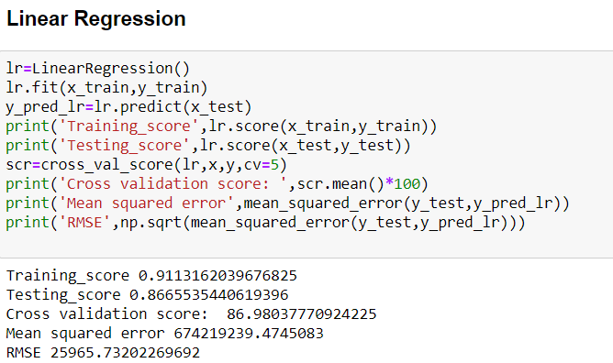
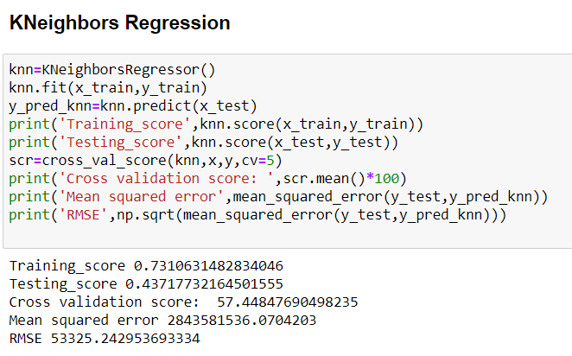
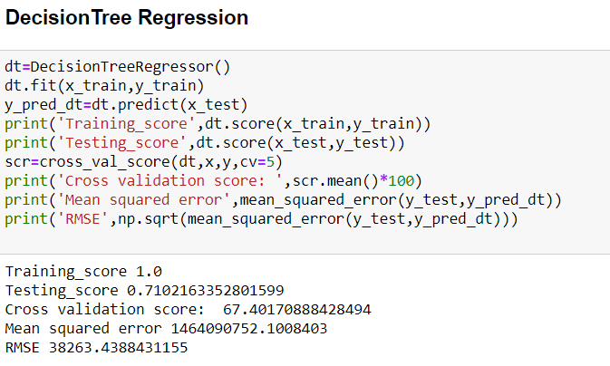
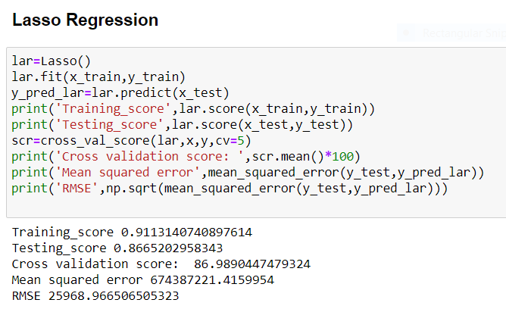
Run and Evaluate selected models

Slide 12
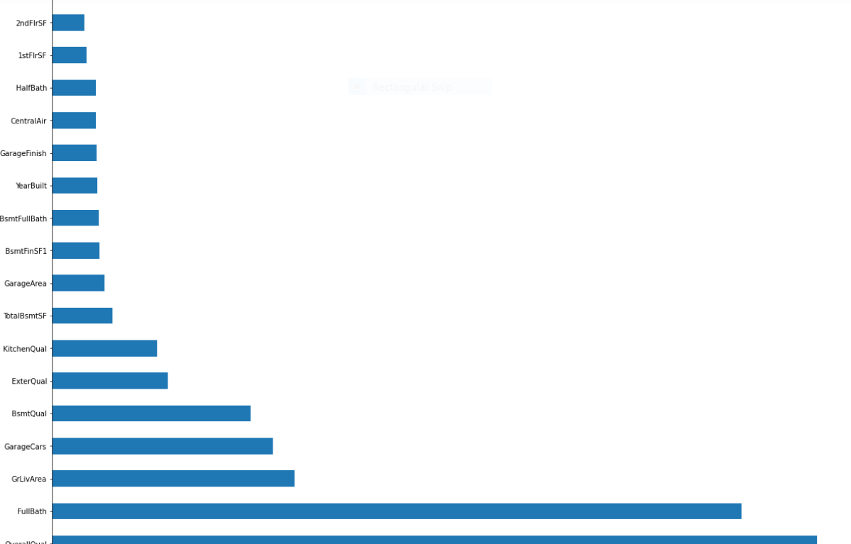
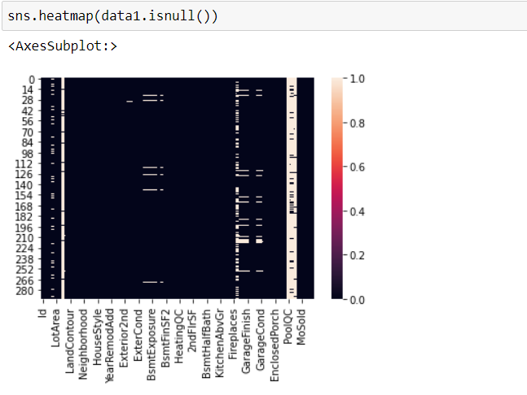
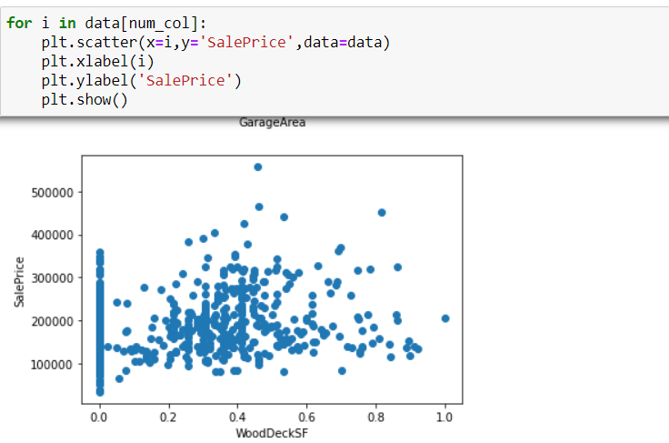
Visualizations
I have plotted heatmap for checking the null values in the columns using the is-null method and found the columns with null values the column which has more null values will be seen as shown in the below figure. I have used scatter plots to check the relation between features and label. I have used Extra Tree Regressor to select the top 30 best features.
Heat map scatter plots Extra Tree Reggresion

Slide 13
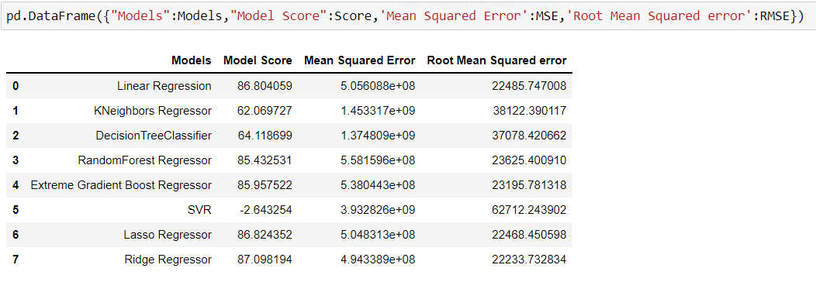
Interpretation of the Results
I have created a data frame using all the models used for prediction, their scores and errors given by the models.

Slide 14
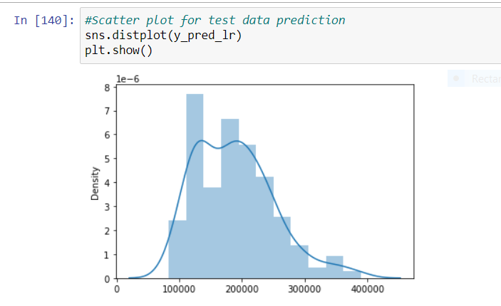
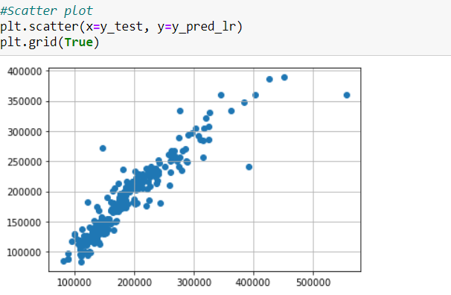
Visualizing our model predicted values

Slide 15
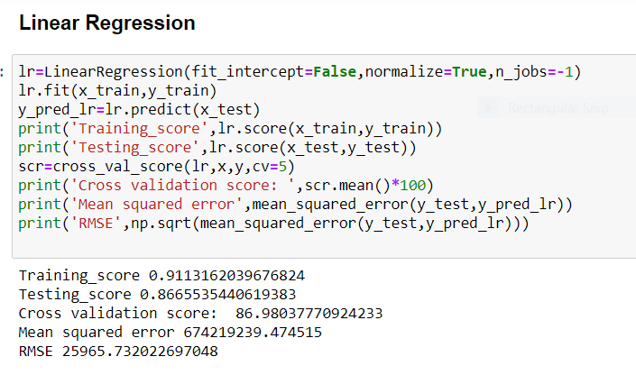
Conclusions on our model building
We got our best model as Linear Regression with the score of 86% and both the training and testing scores are balanced and the RMSE value is also less compared to all other models. So, we can go further build our model as Linear Regression.

Slide 16
Limitations of this work and Scope for Future Work
In the housing project, I have performed many Regression algorithms to predict the house price particle swarm optimization methods to perform house price prediction. The RMSE errors calculated for all the algorithms are very high.
Statistical methods work better, on large set data. But the length of the dataset is very less, so using different methods that match the time-series data will be used in the future research to obtain smaller error prediction values (RMSE) and using more data to get the better result.

